Slide 1

Chapter 1
Introduction
如果没有联想,世界将会怎样
--联想广告语
What would the world be like without Lenovo/Imagination?
Computer Networking: A Top Down Approach
7th Edition, Global Edition
Jim Kurose, Keith Ross
Pearson
April 2016

Slide 2
Chapter 1: introduction
our goal:
get “feel” and terminology
more depth, detail later in course
approach:
  use Internet as example
overview:
what’s the Internet?
what’s a protocol?
network edge; hosts, access net, physical media
network core: packet/circuit switching, Internet structure
performance: loss, delay, throughput
security
protocol layers, service models
history

Slide 3
Chapter 1: roadmap
  1.1 what is the Internet?
  1.2 network edge
    end systems, access networks, links
  1.3 network core
    packet switching, circuit switching, network structure
  1.4 delay, loss, throughput in networks
  1.5 protocol layers, service models
  1.6 networks under attack: security
  1.7 history

Slide 4




















What’s the Internet: “nuts and bolts” view
PC
billions of connected computing devices:
  hosts = end systems
  running network apps
mobile network
server
wireless
laptop
global ISP
smartphone
home
network
communication links
  fiber, copper, radio, satellite
  transmission rate: bandwidth （bit/s bps）
regional ISP
wireless
links
wired
links
packet switches: forward packets (chunks of data)
  routers and switches
router
institutional
network
Notes:
4

Slide 5






“Fun” Internet-connected devices
Web-enabled toaster +
weather forecaster
IP picture frame
http://www.ceiva.com/
Tweet-a-watt:
monitor energy use
Slingbox: watch,
control cable TV remotely
sensorized,
bed
mattress
Internet
refrigerator
Internet phones

Slide 6
What’s the Internet: “nuts and bolts” view
Internet: “network of networks”
  Interconnected ISPs
protocols control sending, receiving of messages
  e.g., TCP, IP, HTTP, Skype, 802.11
Internet standards
  RFC: Request for comments
  IETF: Internet Engineering Task Force
mobile network
global ISP
home
network
regional ISP
institutional
network

Slide 7
What’s the Internet: a service view
infrastructure that provides services to applications:
  Web, VoIP, email, games, e-commerce, social nets, …
provides programming interface to apps
  a platform for apps
  hooks that allow sending and receiving app programs to “connect” to Internet
  provides service options, analogous to postal service
mobile network
global ISP
home
network
regional ISP
institutional
network

Slide 8
1.1.3 What’s a protocol?
human protocols:
“what’s the time?”
“I have a question”
introductions
… specific messages sent
… specific actions taken when messages received, or other events
network protocols:
machines rather than humans
all communication activity in Internet governed by protocols
protocols define format, order of messages sent and received among network entities, and actions taken on message transmission, receipt

Slide 9



What’s a protocol?
a human protocol and a computer network protocol:
Hi
TCP connection
request
Hi
TCP connection
response
Got the
time?
Get http://www.awl.com/kurose-ross
2:00
<file>
time
Q: other human protocols?
Mastering the field of computer networking is equivalent to understanding the what, why, and how of networking protocols

Slide 10
Chapter 1: roadmap
  1.1 what is the Internet?
  1.2 network edge
    end systems, access networks, links
  1.3 network core
    packet switching, circuit switching, network structure
  1.4 delay, loss, throughput in networks
  1.5 protocol layers, service models
  1.6 networks under attack: security
  1.7 history
Notes:
10

Slide 11
A closer look at network structure:
network edge:
  hosts: clients and servers
  servers often in data centers
mobile network
global ISP
access networks, physical media: wired, wireless communication links
home
network
regional ISP
network core:
  interconnected routers
  network of networks
institutional
network
Notes:
资源子网 和 通讯子网

Slide 12
Access networks and physical media
Last Mile or Last Kilometer
Q: How to connect end systems to edge router?
residential access nets
institutional access networks (school, company)
mobile access networks
keep in mind:
bandwidth (bits per second) of access network?
shared or dedicated?

Slide 13
Access network: digital subscriber line (DSL)
central office
telephone
network
DSL
modem
splitter
DSLAM
ISP
voice, data transmitted
at different frequencies over
dedicated line to central office
0-4KHz phone; 4-50KHz upstream data;
50KHz-1MHz downstream data
DSL access
multiplexer
  use existing telephone line to central office DSLAM
    data over DSL phone line goes to Internet
    voice over DSL phone line goes to telephone net
  < 2.5 Mbps upstream transmission rate (typically < 1 Mbps)
  < 24 Mbps downstream transmission rate (typically < 10 Mbps)

Slide 14
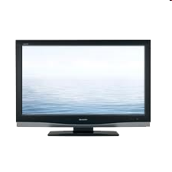


Access network: cable network
cable headend
…
cable
modem
splitter
C
O
N
T
R
O
L
V
I
D
E
O
V
I
D
E
O
V
I
D
E
O
V
I
D
E
O
V
I
D
E
O
V
I
D
E
O
D
A
T
A
D
A
T
A
1
2
3
4
5
6
7
8
9
Channels
frequency division multiplexing: different channels transmitted
in different frequency bands

Slide 15
Access network: cable network
cable headend
…
cable
modem
splitter
CMTS
cable modem
termination system
data, TV transmitted at different
frequencies over shared cable
distribution network
ISP
HFC: hybrid fiber coax
  asymmetric: up to 30Mbps downstream transmission rate, 2 Mbps upstream transmission rate
network of cable, fiber attaches homes to ISP router
  homes share access network to cable headend
  unlike DSL, which has dedicated access to central office

Slide 16







Access network: home network
wireless
devices
to/from headend or central office
often combined
in single box
cable or DSL modem
wireless access
point (54 Mbps)
router, firewall, NAT
wired Ethernet (1 Gbps)

Slide 17









Enterprise access networks (Ethernet)
institutional link to
ISP (Internet)
institutional router
Ethernet
switch
institutional mail,
web servers
typically used in companies, universities, etc.
  10 Mbps, 100Mbps, 1Gbps, 10Gbps transmission rates
  today, end systems typically connect into Ethernet switch

Slide 18








Wireless access networks
shared wireless access network connects end system to router
  via base station aka “access point”
wide-area wireless access
  provided by telco (cellular) operator, 10’s km
  between 1 and 10 Mbps
  3G, 4G: LTE
wireless LANs:
  within building (100 ft.)
  802.11b/g/n (WiFi - Wireless Fidelity): 11, 54, 450 Mbps transmission rate
to Internet
to Internet
Notes:
Aka: also known as

Slide 19

Host: sends packets of data
host sending function:
takes application message
breaks into smaller chunks, known as packets, of length L bits
transmits packet into access network at transmission rate R
  link transmission rate, aka link capacity, aka link bandwidth
two packets,
L bits each
2
1
R: link transmission rate
host
packet
transmission
delay
time needed to
transmit L-bit
packet into link
L (bits)
R (bits/sec)
=
=

Slide 20
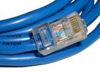
1.2.2 Physical media
bit: propagates between
transmitter/receiver pairs
physical link: what lies between transmitter & receiver
guided media:
  signals propagate in solid media: copper, fiber, coax
unguided media:
  signals propagate freely, e.g., radio
twisted pair (TP)
two insulated copper wires
  Category 5: 100 Mbps, 1 Gbps Ethernet
  Category 6: 10Gbps

Slide 21


Physical media: coax, fiber
coaxial cable:
two concentric copper conductors
bidirectional
broadband:
  multiple channels on cable
  HFC
fiber optic cable:
glass fiber carrying light pulses, each pulse a bit
high-speed operation:
  high-speed point-to-point transmission (e.g., 10’s-100’s Gbps transmission rate)
low error rate:
  repeaters spaced far apart
  immune to electromagnetic noise

Slide 22
Physical media: radio
signal carried in electromagnetic spectrum
no physical “wire”
bidirectional
propagation environment effects:
  reflection
  obstruction by objects
  interference
radio link types:
terrestrial microwave
  e.g. up to 45 Mbps channels
LAN (e.g., WiFi)
  54 Mbps
wide-area (e.g., cellular)
  4G cellular: ~ 10 Mbps
satellite
  Kbps to 45Mbps channel (or multiple smaller channels)
  270 msec end-end delay
  geosynchronous versus low altitude

Slide 23
Chapter 1: roadmap
  1.1 what is the Internet?
  1.2 network edge
    end systems, access networks, links
  1.3 network core
    packet switching, circuit switching, network structure
  1.4 delay, loss, throughput in networks
  1.5 protocol layers, service models
  1.6 networks under attack: security
  1.7 history
Notes:
23

Slide 24









The network core
mesh of interconnected routers
packet-switching: hosts break application-layer messages into packets
  forward packets from one router to the next, across links on path from source to destination
  each packet transmitted at full link capacity

Slide 25



Packet-switching: store-and-forward
L bits
per packet
source
3
2
1
R bps
R bps
destination
takes L/R seconds to transmit (push out) L-bit packet into link at R bps
store and forward: entire packet must arrive at router before it can be transmitted on next link
one-hop numerical example:
L = 7.5 Mbits
R = 1.5 Mbps
one-hop transmission delay = 5 sec
end-end delay = 2L/R (assuming zero propagation delay)
more on delay shortly …

Slide 26
Packet Switching: queueing delay, loss
R = 100 Mb/s
C
A
D
R = 1.5 Mb/s
B
E
queue of packets
waiting for output link
queuing and loss:
if arrival rate (in bits) to link exceeds transmission rate of link for a period of time:
  packets will queue, wait to be transmitted on link
  packets can be dropped (lost) if memory (buffer) fills up

Slide 27
Two key network-core functions
routing: determines source-destination route taken by packets
  routing algorithms
forwarding: move packets from router’s input to appropriate router output
routing algorithm
local forwarding table
header value
output link
0100
0101
0111
1001
3
2
2
1
1
3
2
0111
destination address in arriving
packet’s header

Slide 28
Alternative core: circuit switching
end-end resources allocated to, reserved for “call” between source & dest:
in diagram, each link has four circuits.
  call gets 2nd circuit in top link and 1st circuit in right link.
dedicated resources: no sharing
  circuit-like (guaranteed) performance
circuit segment idle if not used by call (no sharing)
commonly used in traditional telephone networks

Slide 29
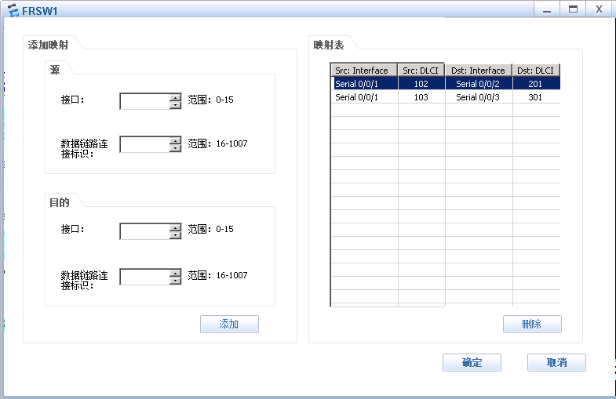
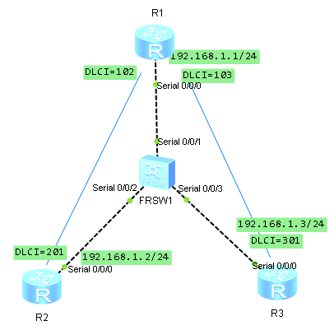
Virtual Circuit in Frame Relay

Slide 30
Circuit switching: FDM versus TDM
Example:
FDM:Frequency-division multiplexing
4 users
frequency
time
TDM：Time-Division Multiplexing
frequency
time

Slide 31
Packet switching versus circuit switching
packet switching allows more users to use network!
example:
1 Mb/s link
each user:
  100 kb/s when “active”
  active 10% of time
circuit-switching:
  10 users
packet switching:
  with 35 users, probability > 10 active at same time is less than .0004 *
N
users
…..
1 Mbps link
Q: how did we get value 0.0004?
Q: what happens if > 35 users ?
* Check out the online interactive exercises for more examples: http://gaia.cs.umass.edu/kurose_ross/interactive/

Slide 32
Packet switching versus circuit switching
is packet switching a “slam dunk winner?”
great for bursty data
  resource sharing
  simpler, no call setup
excessive congestion possible: packet delay and loss
  protocols needed for reliable data transfer, congestion control
Q: How to provide circuit-like behavior?
  bandwidth guarantees needed for audio/video apps
  still an unsolved problem (chapter 7)
Q: human analogies of reserved resources (circuit switching) versus on-demand allocation (packet-switching)?

Slide 33
1.3.3 Internet structure: network of networks
End systems connect to Internet via access ISPs (Internet Service Providers)
  residential, company and university ISPs
Access ISPs in turn must be interconnected.
  so that any two hosts can send packets to each other
Resulting network of networks is very complex
  evolution was driven by economics and national policies
Let’s take a stepwise approach to describe current Internet structure

Slide 34
Internet structure: network of networks
Question: given millions of access ISPs, how to connect them together?
…
…
access
net
access
net
access
net
access
net
access
net
access
net
access
net
…
…
access
net
access
net
access
net
access
net
access
net
access
net
…
access
net
access
net
…
access
net

Slide 35
Internet structure: network of networks
Option: connect each access ISP to every other access ISP?
…
…
access
net
access
net
access
net
access
net
access
net
…
…
access
net
access
net
…
connecting each access ISP to each other directly doesn’t scale: O(N²) connections.
…
…
access
net
access
net
…
access
net
access
net
access
net
…
access
net
…
access
net
access
net
…
access
net

Slide 36
Internet structure: network of networks
Option 1: connect each access ISP to one global transit ISP?
Customer and provider ISPs have economic agreement.
…
…
access
net
access
net
access
net
access
net
access
net
access
net
access
net
…
…
global
ISP
access
net
access
net
access
net
access
net
access
net
access
net
…
access
net
access
net
…
access
net

Slide 37
Internet structure: network of networks
Option 2: But if one global ISP is viable business, there will be competitors ….
…
…
access
net
access
net
access
net
access
net
access
net
access
net
ISP A
access
net
…
…
access
net
ISP B
access
net
ISP C
access
net
access
net
access
net
access
net
…
access
net
access
net
…
access
net

Slide 38
Internet structure: network of networks
Option 3: But if one global ISP is viable business, there will be competitors …. which must be interconnected
Internet exchange point
…
…
access
net
access
net
access
net
access
net
access
net
IXP
access
net
access
net
ISP A
…
…
access
net
IXP
ISP B
access
net
ISP C
access
net
access
net
peering link
access
net
access
net
…
access
net
access
net
…
access
net

Slide 39
Internet structure: network of networks
Option 4: … and regional networks may arise to connect access nets to ISPs
…
…
access
net
access
net
access
net
access
net
access
net
IXP
access
net
access
net
ISP A
…
…
access
net
IXP
ISP B
access
net
ISP C
access
net
access
net
access
net
regional net
access
net
…
access
net
access
net
…
access
net

Slide 40
Internet structure: network of networks
Option 5: … and content provider networks (e.g., Google, Microsoft, Akamai) may run their own network, to bring services, content close to end users
…
…
access
net
access
net
access
net
access
net
access
net
IXP
access
net
access
net
ISP A
…
…
Content provider network
access
net
IXP
ISP B
access
net
ISP C
access
net
access
net
access
net
regional net
access
net
…
access
net
access
net
…
access
net
Notes:
Google估计有30-50个数据中心部署在北美、欧洲、亚洲、南美和澳大利亚，每个中心超过10万台服务器。该CPN网络跨越全球，但独立于公共因特网

Slide 41
Internet structure: network of networks
Tier 1 ISP
Tier 1 ISP
Google
IXP
IXP
IXP
Regional ISP
Regional ISP
access
ISP
access
ISP
access
ISP
access
ISP
access
ISP
access
ISP
access
ISP
access
ISP
at center: small # of well-connected large networks
  “tier-1” commercial ISPs (e.g., Level 3, AT&T, Verizon, T-mobile, Sprint, NTT), national & international coverage
  content provider network (e.g., Google): private network that connects it data centers to Internet, often bypassing tier-1, regional ISPs

Slide 42
Tier-1 ISP: e.g., Sprint
POP: point-of-presence
to/from backbone
peering
…
…
…
…
…
to/from customers
Notes:
POP:存在点

Slide 43
Chapter 1: roadmap
  1.1 what is the Internet?
  1.2 network edge
    end systems, access networks, links
  1.3 network core
    packet switching, circuit switching, network structure
  1.4 delay, loss, throughput in networks
  1.5 protocol layers, service models
  1.6 networks under attack: security
  1.7 history
Notes:
43
throughput 英 [ˈθru:pʊt] 美 [ˈθruˌpʊt] n. 生产量，生产能力，吞吐量;流率

Slide 44
How do loss and delay occur?
packets queue in router buffers
packet arrival rate to link (temporarily) exceeds output link capacity
packets queue, wait for turn
packet being transmitted (delay)
A
B
packets queueing (delay)
free (available) buffers: arriving packets
dropped (loss) if no free buffers

Slide 45
Four sources of packet delay
transmission
A
propagation
B
nodal
processing
queueing
d_{nodal} = d_{proc} + d_{queue} + d_{trans} + d_{prop}
d_{proc}: nodal processing
check bit errors
determine output link
typically < msec
d_{queue}: queueing delay
time waiting at output link for transmission
depends on congestion level of router

Slide 46
Four sources of packet delay
transmission
A
propagation
B
nodal
processing
queueing
d_{nodal} = d_{proc} + d_{queue} + d_{trans} + d_{prop}
d_{trans}: transmission delay:
L: packet length (bits)
R: link bandwidth (bps)
d_{trans} = L/R
d_{prop}: propagation delay:
d: length of physical link
s: propagation speed (~2x10⁸ m/sec)
d_{prop} = d/s
d_{trans} and d_{prop}
very different
* Check out the online interactive exercises for more examples: http://gaia.cs.umass.edu/kurose_ross/interactive/
* Check out the Java applet for an interactive animation on trans vs. prop delay
Notes:
46
光速每秒30万公里

Slide 47
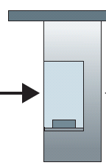
Caravan analogy
100 km
100 km
ten-car
caravan
toll
booth
toll
booth
cars “propagate” at
100 km/hr
toll booth takes 12 sec to service car (bit transmission time)
car ~ bit; caravan ~ packet
Q: How long until caravan is lined up before 2nd toll booth?
time to “push” entire caravan through toll booth onto highway = 12*10 = 120 sec
time for last car to propagate from 1st to 2nd toll both: 100km/(100km/hr)= 1 hr
A: 62 minutes
Notes:
Caravan analogy [əˈnælədʒi]商队（车队）类比

Slide 48
Caravan analogy (more)
100 km
100 km
ten-car
caravan
toll
booth
toll
booth
suppose cars now “propagate” at 1000 km/hr
and suppose toll booth now takes one min to service a car
Q: Will cars arrive to 2nd booth before all cars serviced at first booth?
A: Yes! after 7 min, first car arrives at second booth; three cars still at first booth
Notes:
此时造成排除时延，因为路由器要存储转发，必须等所有BIT都到达了才转发

Slide 49
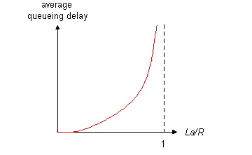

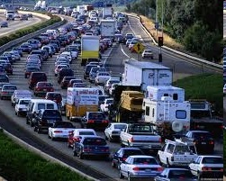
Queueing delay (revisited)
R: link bandwidth (bps)
L: packet length (bits)
a: average packet arrival rate – periodically or in brusts
average queueing delay
traffic intensity
= La/R
La/R ~ 0: avg. queueing delay small
La/R -> 1: avg. queueing delay large
La/R > 1: more “work” arriving
than can be serviced, average delay infinite!
La/R ~ 0
La/R -> 1
* Check online interactive animation on queuing and loss
Notes:
traffic intensity 流量强度

Slide 50
“Real” Internet delays and routes
what do “real” Internet delay & loss look like?
traceroute program: provides delay measurement from source to router along end-end Internet path towards destination. For all i:
  sends three packets that will reach router i on path towards destination
  router i will return packets to sender
  sender times interval between transmission and reply.
3 probes
3 probes
3 probes

Slide 51
“Real” Internet delays, routes
traceroute: gaia.cs.umass.edu to www.eurecom.fr
3 delay measurements from
gaia.cs.umass.edu to cs-gw.cs.umass.edu
1 cs-gw (128.119.240.254) 1 ms 1 ms 2 ms
2 border1-rt-fa5-1-0.gw.umass.edu (128.119.3.145) 1 ms 1 ms 2 ms
3 cht-vbns.gw.umass.edu (128.119.3.130) 6 ms 5 ms 5 ms
4 jn1-at1-0-0-19.wor.vbns.net (204.147.132.129) 16 ms 11 ms 13 ms
5 jn1-so7-0-0-0.wae.vbns.net (204.147.136.136) 21 ms 18 ms 18 ms
6 abilene-vbns.abilene.ucaid.edu (198.32.11.9) 22 ms 18 ms 22 ms
7 nycm-wash.abilene.ucaid.edu (198.32.8.46) 22 ms 22 ms 22 ms
8 62.40.103.253 (62.40.103.253) 104 ms 109 ms 106 ms
9 de2-1.de1.de.geant.net (62.40.96.129) 109 ms 102 ms 104 ms
10 de.fr1.fr.geant.net (62.40.96.50) 113 ms 121 ms 114 ms
11 renater-gw.fr1.fr.geant.net (62.40.103.54) 112 ms 114 ms 112 ms
12 nio-n2.cssi.renater.fr (193.51.206.13) 111 ms 114 ms 116 ms
13 nice.cssi.renater.fr (195.220.98.102) 123 ms 125 ms 124 ms
14 r3t2-nice.cssi.renater.fr (195.220.98.110) 126 ms 126 ms 124 ms
15 eurecom-valbonne.r3t2.ft.net (193.48.50.54) 135 ms 128 ms 133 ms
16 194.214.211.25 (194.214.211.25) 126 ms 128 ms 126 ms
17 * * *
18 * * *
19 fantasia.eurecom.fr (193.55.113.142) 132 ms 128 ms 136 ms
trans-oceanic
link
* means no response (probe lost, router not replying)
* Do some traceroutes from exotic countries at www.traceroute.org

Slide 52
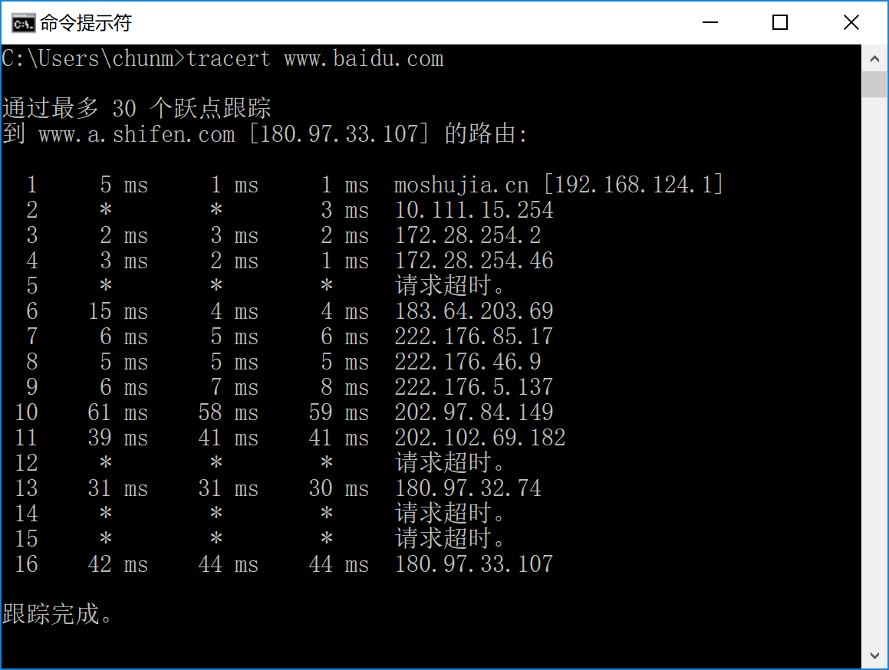

Slide 53
Packet loss
queue (aka buffer) preceding link in buffer has finite capacity
packet arriving to full queue dropped (aka lost)
lost packet may be retransmitted by previous node, by source end system, or not at all
buffer
(waiting area)
A
packet being transmitted
B
packet arriving to
full buffer is lost
* Check out the Java applet for an interactive animation on queuing and loss

Slide 54
Throughput
throughput: rate (bits/time unit) at which bits transferred between sender/receiver
  instantaneous: rate at given point in time
  average: rate over longer period of time
server, with
file of F bits
to send to client
link capacity
R_{s} bits/sec
link capacity
R_{c} bits/sec
server sends bits
(fluid) into pipe
pipe that can carry
fluid at rate
R_{s} bits/sec)
pipe that can carry
fluid at rate
R_{c} bits/sec)

Slide 55
Throughput (more)
R_{s} < R_{c} What is average end-end throughput?
R_{s} bits/sec
R_{c} bits/sec
R_{s} > R_{c} What is average end-end throughput?
R_{s} bits/sec
R_{c} bits/sec
bottleneck link
link on end-end path that constrains end-end throughput

Slide 56
Throughput: Internet scenario
per-connection end-end throughput: min(R_{c},R_{s},R/10)
in practice: R_{c} or R_{s} is often bottleneck
R_{s}
R_{s}
R_{s}
R
R_{c}
R_{c}
R_{c}
10 connections (fairly) share backbone bottleneck link R bits/sec
* Check out the online interactive exercises for more examples: http://gaia.cs.umass.edu/kurose_ross/interactive/
Notes:
scenario 英 [səˈnɑ:riəʊ] 美 [səˈnærioʊ] n. （行动的）方案;剧情概要;分镜头剧本

Slide 57
Chapter 1: roadmap
  1.1 what is the Internet?
  1.2 network edge
    end systems, access networks, links
  1.3 network core
    packet switching, circuit switching, network structure
  1.4 delay, loss, throughput in networks
  1.5 protocol layers, service models
  1.6 networks under attack: security
  1.7 history
Notes:
57

Slide 58
Protocol “layers”
Networks are complex,
with many “pieces”:
  hosts
  routers
  links of various media
  applications
  protocols
  hardware
  software
Question:
is there any hope of organizing structure of network?
…. or at least our discussion of networks?

Slide 59
Organization of air travel
ticket (purchase)
baggage (check)
gates (load)
runway takeoff
airplane routing
ticket (complain)
baggage (claim)
gates (unload)
runway landing
airplane routing
airplane routing
a series of steps

Slide 60
Layering of airline functionality
ticket (purchase)
baggage (check)
gates (load)
runway (takeoff)
airplane routing
ticket (complain)
baggage (claim
gates (unload)
runway (land)
airplane routing
ticket
baggage
gate
takeoff/landing
airplane routing
airplane routing
airplane routing
departure
airport
intermediate air-traffic
control centers
arrival
airport
layers: each layer implements a service
  via its own internal-layer actions
  relying on services provided by layer below

Slide 61
Why layering?
dealing with complex systems:
explicit structure allows identification, relationship of complex system’s pieces
  layered reference model for discussion
modularization eases maintenance, updating of system
  change of implementation of layer’s service transparent to rest of system
  e.g., change in gate procedure doesn’t affect rest of system
layering considered harmful? - drawback
  One layer may duplicate lower-layer functionality (e.g. error recovery)
  Functionality at one layer may need info present only in another layer (e.g. timestamp)
Notes:
explicit structure 清晰的结构，显式结构
Implicit and explicit structure隐式和显式

Slide 62
Internet protocol stack
application: supporting network applications
  FTP, SMTP, HTTP
transport: process-process data transfer
  TCP, UDP
network: routing of datagrams from source to destination
  IP, routing protocols
link: data transfer between neighboring network elements
  Ethernet, 802.111 (WiFi), PPP
physical: bits “on the wire”
  Link-dependent
application
transport
network
link
physical

Slide 63
ISO/OSI reference model
presentation: allow applications to interpret meaning of data, e.g., encryption, compression, machine-specific conventions
session: synchronization, checkpointing, recovery of data exchange
Internet stack “missing” these layers!
  these services, if needed, must be implemented in application
  needed?
application
presentation
session
transport
network
link
physical
Notes:
machine-specific conventions特定于机器的约定
session: synchronization, checkpointing, recovery of data exchange会话：同步、检查点、数据交换恢复

Slide 64
Encapsulation
source
message
M
application
transport
network
link
physical
segment
H_{t}
M
H_{t}
datagram
H_{n}
H_{n}
H_{t}
M
frame
H_{l}
H_{n}
H_{t}
M
link
physical
switch
destination
H_{n}
H_{t}
M
network
link
physical
M
application
transport
network
link
physical
H_{l}
H_{n}
H_{t}
M
H_{n}
H_{t}
M
H_{t}
M
H_{n}
H_{t}
M
H_{l}
H_{n}
H_{t}
M
router

Slide 65
Chapter 1: roadmap
  1.1 what is the Internet?
  1.2 network edge
    end systems, access networks, links
  1.3 network core
    packet switching, circuit switching, network structure
  1.4 delay, loss, throughput in networks
  1.5 protocol layers, service models
  1.6 networks under attack: security
  1.7 history
Notes:
65

Slide 66
Network security
field of network security:
  how bad guys can attack computer networks
  how we can defend networks against attacks
  how to design architectures that are immune to attacks
Internet not originally designed with (much) security in mind
  original vision: “a group of mutually trusting users attached to a transparent network” ☺
  Internet protocol designers playing “catch-up”
  security considerations in all layers!

Slide 67
Bad guys: put malware into hosts via Internet
malware can get in host from:
  virus: self-replicating infection by receiving/executing object (e.g., e-mail attachment)
  worm: self-replicating infection by passively receiving object that gets itself executed
spyware malware can record keystrokes, web sites visited, upload info to collection site
infected host can be enrolled in botnet, used for spam, DDoS attacks
Notes:
Replicate 英 [ˈreplɪˌkeɪt] 美 [ˈrɛplɪˌket] vt. 复制，复写; 重复，反复; 折转; [生] 复制;
keystroke 英 [ˈki:strəʊk] 美 [ˈki:stroʊk] n. 键击，按键

Slide 68
Bad guys: attack server, network infrastructure
Denial of Service (DoS): attackers make resources (server, bandwidth) unavailable to legitimate traffic by overwhelming resource with bogus traffic
1. select target
2. break into hosts around the network (see botnet)
3. send packets to target from compromised hosts
target
Notes:
legitimate 英 [lɪˈdʒɪtɪmət] 美 [ləˈdʒɪtəmɪt] adj. 合法的，合理的;
bogus [ˈbəʊgəs] adj. 假冒的，伪造的;佯作
compromised hosts受损主机

Slide 69
Bad guys can sniff packets
packet “sniffing”:
  broadcast media (shared Ethernet, wireless)
  promiscuous network interface reads/records all packets (e.g., including passwords!) passing by
A
C
src:B dest:A payload
B
  wireshark software used for end-of-chapter labs is a (free) packet-sniffer
Notes:
promiscuous 美 [prəˈmɪskjuəs] adj. 淫乱;混杂的;（尤指）性关系随便的;随便的
promiscuous network interface 混杂模式的网络接口

Slide 70
Bad guys can use fake addresses
IP spoofing: send packet with false source address
A
C
src:B dest:A payload
B
… lots more on security (throughout, Chapter 8)

Slide 71
Chapter 1: roadmap
  1.1 what is the Internet?
  1.2 network edge
    end systems, access networks, links
  1.3 network core
    packet switching, circuit switching, network structure
  1.4 delay, loss, throughput in networks
  1.5 protocol layers, service models
  1.6 networks under attack: security
  1.7 history
Notes:
71

Slide 72
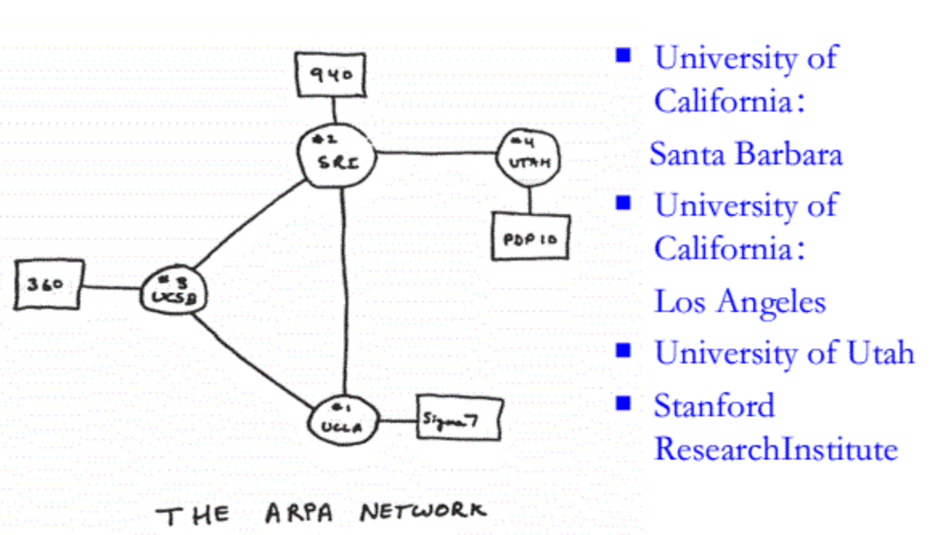
Internet history
1961-1972: Early packet-switching principles
1961: Kleinrock （MIT） - queueing theory shows effectiveness of packet-switching
1964: Baran - packet-switching in military nets
1967: ARPAnet conceived by Advanced Research Projects Agency
1969: first ARPAnet node operational
1972:
  ARPAnet public demo
  NCP (Network Control Protocol) first host-host protocol
  first e-mail program
  ARPAnet has 15 nodes
Notes:
加州大学洛杉矶分校（UCLA）斯坦福研究院（SRI）加州大学圣巴巴拉分校（UCSB）和犹他大学（UTAH）

Slide 73
Internet history
1972-1980: Internetworking, new and proprietary nets
1970: ALOHAnet satellite network in Hawaii
1974: Cerf and Kahn - architecture for interconnecting networks
1976: Ethernet at Xerox PARC
late70’s: proprietary architectures: DECnet (1975), SNA(IBM,1974), XNA
late 70’s: switching fixed length packets (ATM precursor)
1979: ARPAnet has 200 nodes
Cerf and Kahn’s internetworking principles:
  minimalism, autonomy - no internal changes required to interconnect networks
  best effort service model
  stateless routers
  decentralized control
define today’s Internet architecture
Notes:
proprietary 英 [prəˈpraɪətri] 美 [prəˈpraɪəteri] adj. 专有的，专利的;所有（人）的;（商品）专卖的
Xerox 英 [ˈzɪərɒks] 美 [ˈzɪrɑ:ks]
precursor 英 [pri:ˈkɜ:sə(r)] 美 [pri:ˈkɜ:rsə(r)] n. 前辈，前驱，先锋，前任;预兆，先兆，初期形式;[核]前驱波，初级粒子;预报器
minimalism, autonomy - no internal changes required to interconnect networks 最低限度、自主性-无需内部更改即可互连网络
Cerf and Kahn瑟夫和卡恩（康）
minimalism, autonomy 极简主义，自主的

Slide 74
Internet history
1980-1990: new protocols, a proliferation of networks
1983: deployment of TCP/IP
1982: smtp e-mail protocol defined
1983: DNS defined for name-to-IP-address translation
1985: ftp protocol defined
1988: TCP congestion control
new national networks: CSnet, BITnet, NSFnet, Minitel
100,000 hosts connected to confederation of networks
Notes:
confederation联盟; 结盟; 同盟国
计算机科学研究网络（CSNET，Computer Science Research Network），加拿大网络（CDnet，Canadian Network），因时网（BITNET，Because It's Time Network）和美国国家自然科学基金网络（NSFnet，National Science Foundation Network）

Slide 75
Internet history
1990, 2000’s: commercialization, the Web, new apps
early 1990’s: ARPAnet decommissioned
1991: NSF lifts restrictions on commercial use of NSFnet (decommissioned, 1995)
early 1990s: Web
  hypertext [Bush 1945, Nelson 1960’s]
  HTML, HTTP: Berners-Lee
  1994: Mosaic, later Netscape
  late 1990’s: commercialization of the Web
late 1990’s – 2000’s:
more killer apps: instant messaging, P2P file sharing
network security to forefront
est. 50 million host, 100 million+ users
backbone links running at Gbps
Notes:
lifts restrictions取消限制
forefront n. 前列;最前部;活动中心;第一线

Slide 76
Internet history
2005-present
~5B devices attached to Internet (2016)
  smartphones and tablets
aggressive deployment of broadband access
increasing ubiquity of high-speed wireless access
emergence of online social networks:
  Facebook: ~ one billion users
service providers (Google, Microsoft) create their own networks
  bypass Internet, providing “instantaneous” access to search, video content, email, etc.
e-commerce, universities, enterprises running their services in “cloud” (e.g., Amazon EC2)
Notes:
aggressive deployment of broadband access宽带接入的积极部署

Slide 77
Introduction: summary
covered a “ton” of material!
Internet overview
what’s a protocol?
network edge, core, access network
  packet-switching versus circuit-switching
  Internet structure
performance: loss, delay, throughput
layering, service models
security
history
you now have:
context, overview, “feel” of networking
more depth, detail to follow!

Slide 78
Chapter 1
Additional Slides

Slide 79

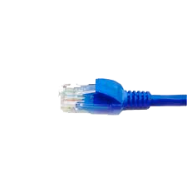
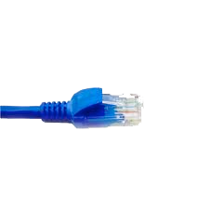
application
(www browser,
email client)
packet
analyzer
application
OS
packet
capture
(pcap)
Transport (TCP/UDP)
Network (IP)
Link (Ethernet)
Physical
copy of all Ethernet frames sent/received

